Slide 1
Computer Abstractions and Technology
Dr. Rajib Ranjan Maiti
CSIS, BITS-Pilani, Hyderabad
Disclaimer: To know the complete syllabus, handout and the text book should be consulted

Slide 2
Teaching Policy and Logistics
Lab Test 1 and 2 (Tentative: 6th Oct & 1st Dec 5:15PM – 6:15PM)
Code Writing (2) + Error free sample test case (3) + TC1 (5) + TC2 (5) + TC3 (5) = 20 marks
Quiz 1 and 2 (Tentative: 3rd Oct & 28 Nov 5:15PM – 5:35PM)
10 x 1 = 10 marks (MCQ)
Mid Sem Pattern (14/10 9:30 – 11:00)
1x12 + 8x2x3 = 60 marks (either 0 or full marks for each question)
Compre Pattern (20/12 9:30 – 12:30)
1x20 + 10x2x3 = 80 marks (either 0 or full marks for each question)
Key release:
immediately after exam
Key verification time : 24 hours after key release
Key release on notice board in front of H101
Make up :
no make up for Quiz and Lab Test

Slide 3
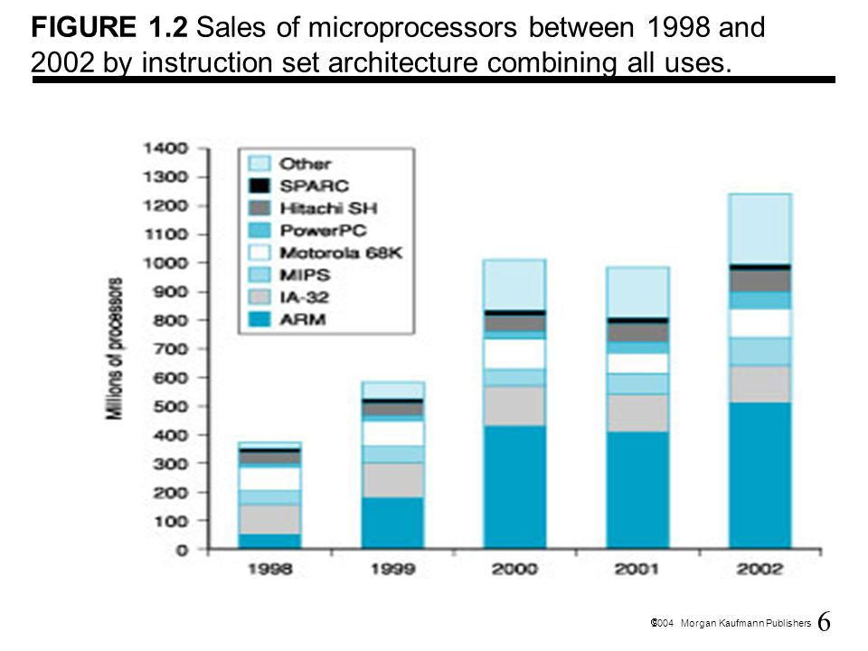
What market says about the processors?

Slide 4
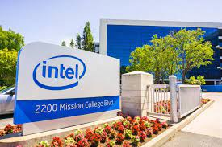
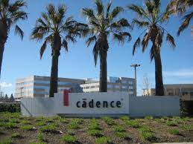
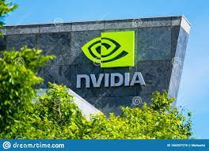





Top Industries interested in Comp Arch Specialists

Slide 5

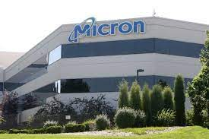
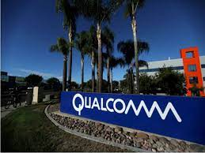



Top Industries interested in Comp Arch Specialists

Slide 6
Internet of Things/Embedded Computers
Embedded computers have
the widest spread of processing power and cost
Embedded computers include
8-bit to 32-bit processors that may cost one penny
high-end 64-bit processors for cars and network switches that cost $100.
The primary goal of embedded computer
the performance at a minimum price,
Rejects, achieving more performance at a higher price

Slide 7
Understanding Program Performance
Hardware or software component | How this component affects performance | CA covers this topic?
Algorithm | Determines both the number of source-level statements and the number of I/O operations executed | No!!!
Programming language, compiler, and architecture | Determines the number of machine instructions for each source-level statement | Chapters 2 and 3 (181 pages)
Processor and memory system | Determines how fast instructions can be executed | Chapters 5, 6, and 7 (271 pages)
I/O system (hardware and operating system) | Determines how fast I/O operations may be executed | Chapter 8 (41 pages)

Slide 8
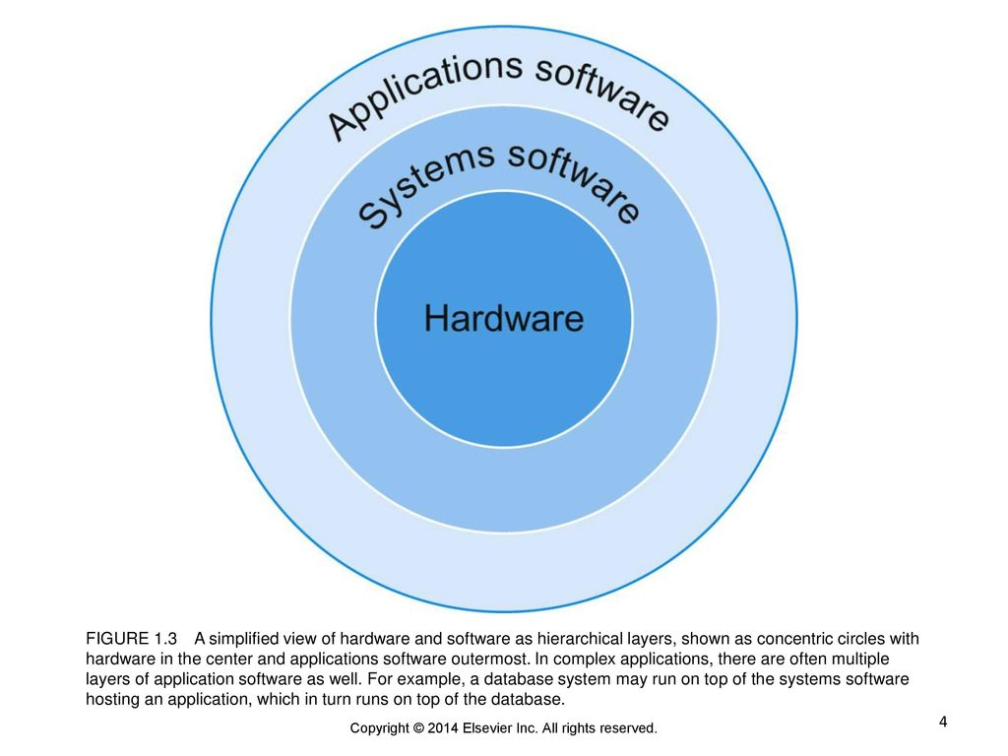
Below Your Program

Slide 9
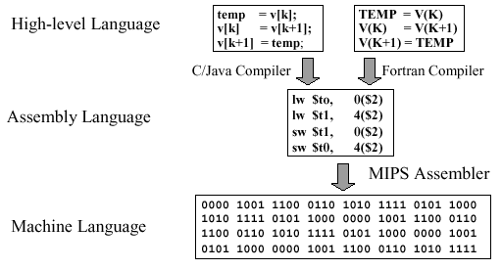
Below Your Program

Slide 10
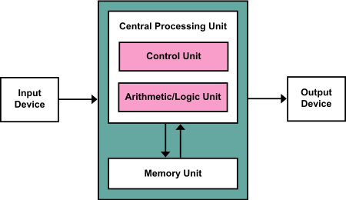
Von Neumann architecture
based on
a 1945 description by John von Neumann
describes
a design architecture for an electronic digital computer
Four main components
CPU, Memory, Input Device, Output Device
refer to any stored-program computer in which
an instruction fetch and a data operation cannot occur at the same time (since they share a common bus)
simpler than in a Harvard architecture machine

Slide 11
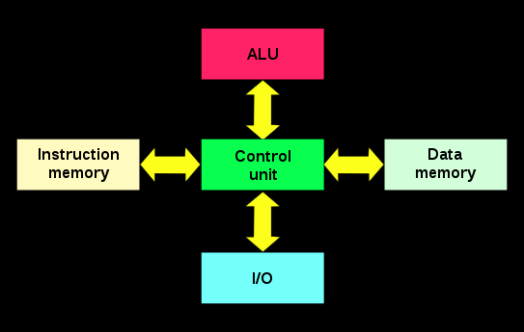
Harvard architecture
separate storage and signal pathways for instructions and data
the CPU can both read an instruction and perform a data memory access at the same time even without a cache
can thus be faster for a given circuit complexity because instruction fetches and data access do not contend for a single memory pathway
has distinct code and data address spaces:
instruction address zero is not the same as data address zero
Instruction address zero might identify a twenty-four-bit value,
while data address zero might indicate an eight-bit byte that is not part of that twenty-four-bit value

Slide 12
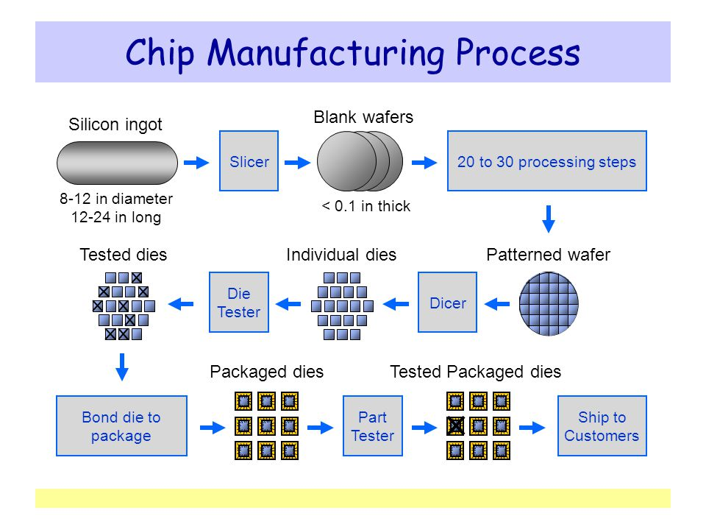
silicon crystal ingot A rod
composed of a silicon crystal that is between 6 and 12 inches in diameter and about 12 to 24 inches long.
wafer A slice from a silicon
ingot no more than 0.1 inch thick, used to create chips.
die The individual rectangular sections that are cut from a wafer, more informally known as chips.

Slide 13
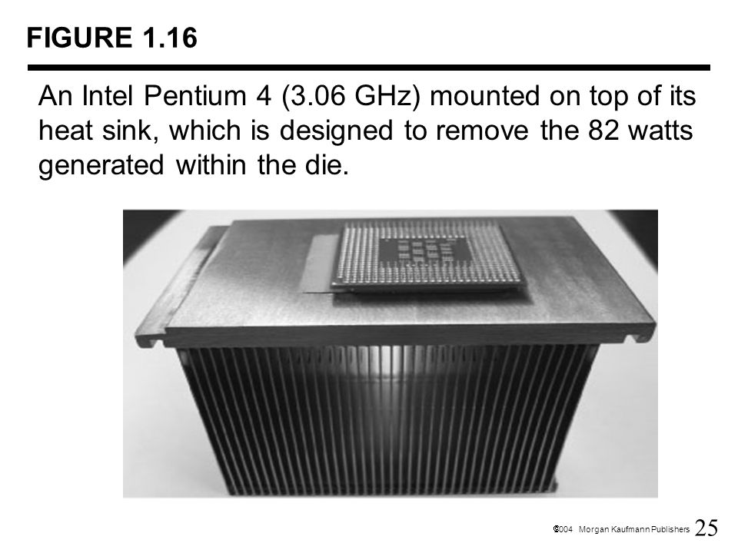
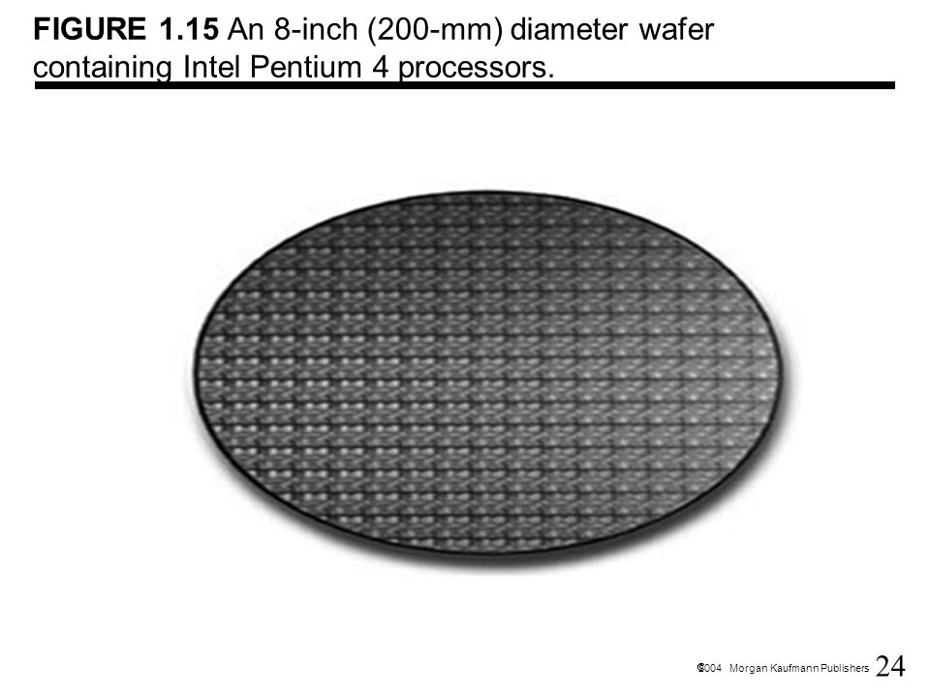
An example

Slide 14
Performance Measures

Slide 15
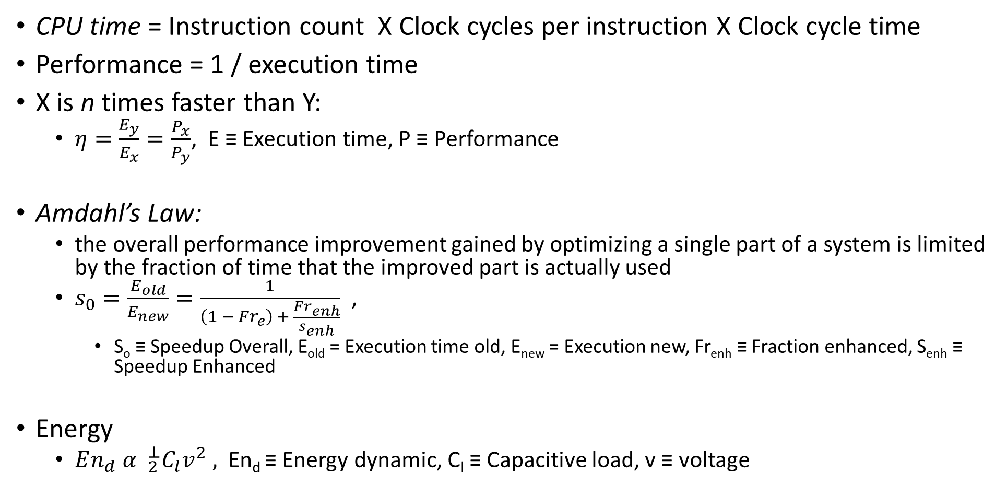
Important Formulas
CPU time = Instruction count X Clock cycles per instruction X Clock cycle time
Performance = 1 / execution time
X is n times faster than Y:
$η=\frac{E_{y}}{E_{x}}=\frac{P_{x}}{P_{y}}$, E ≡ Execution time, P ≡ Performance
Amdahl’s Law:
the overall performance improvement gained by optimizing a single part of a system is limited by the fraction of time that the improved part is actually used
$s_{0}=\frac{E_{old}}{E_{new}}=\frac{1}{\left(1 − Fr_{e}\right) + \frac{Fr_{enh}}{s_{enh}}}$ ,
S_{o} ≡ Speedup Overall, E_{old} = Execution time old, E_{new} = Execution new, Fr_{enh} ≡ Fraction enhanced, S_{enh} ≡ Speedup Enhanced
Energy
$En_{d}{ α }_{2}^{⊥}C_{l}v^{2} ,$ En_{d} ≡ Energy dynamic, C_{l} ≡ Capacitive load, v ≡ voltage

Slide 16
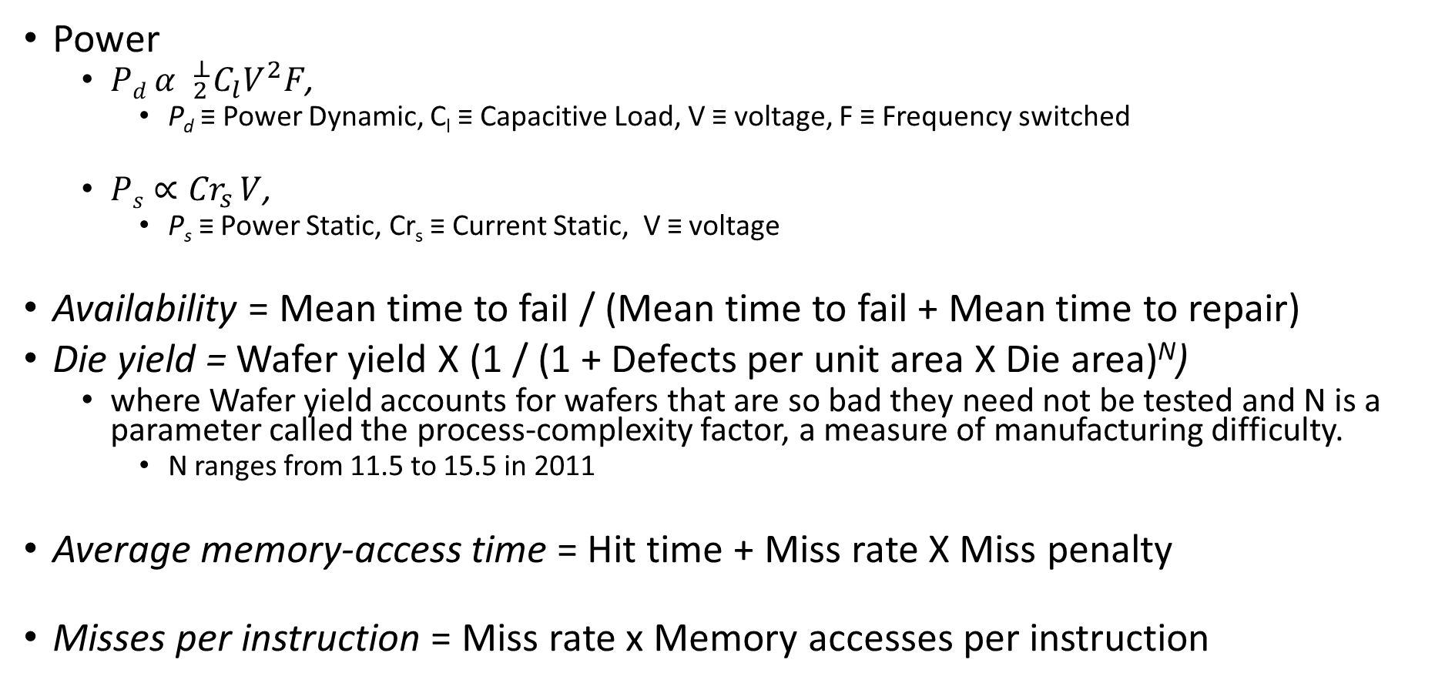
Important Formulas
Power
$Pd{ α }_{2}^{⊥}C_{l}V^{2}F$,
P_{d} ≡ Power Dynamic, C_{l} ≡ Capacitive Load, V ≡ voltage, F ≡ Frequency switched
$Ps∝{Cr}_{s }V$,
P_{s} ≡ Power Static, Cr_{s} ≡ Current Static, V ≡ voltage
Availability = Mean time to fail / (Mean time to fail + Mean time to repair)
Die yield = Wafer yield X (1 / (1 + Defects per unit area X Die area)^{N})
where Wafer yield accounts for wafers that are so bad they need not be tested and N is a parameter called the process-complexity factor, a measure of manufacturing difficulty.
N ranges from 11.5 to 15.5 in 2011
Average memory-access time = Hit time + Miss rate X Miss penalty
Misses per instruction = Miss rate x Memory accesses per instruction

Slide 17
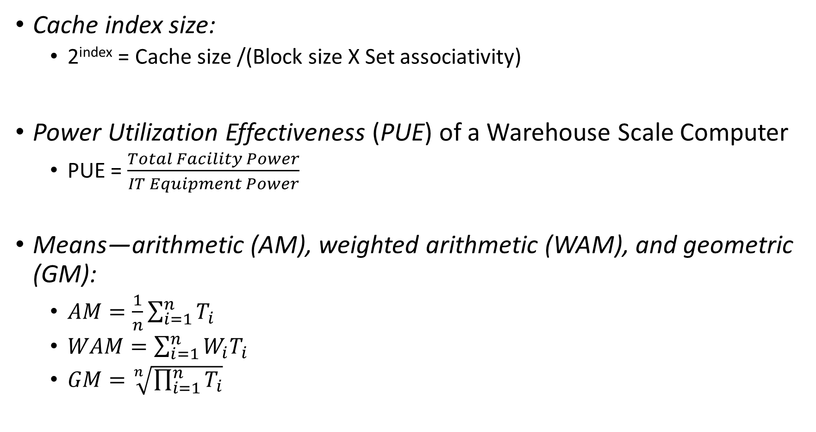
Important Formulas
Cache index size:
2^{index} = Cache size /(Block size X Set associativity)
Power Utilization Effectiveness (PUE) of a Warehouse Scale Computer
PUE = $\frac{Total Facility Power}{IT Equipment Power}$
Means—arithmetic (AM), weighted arithmetic (WAM), and geometric (GM):
$AM=\frac{1}{n}\sum_{i=1}^{n}{T_{i}}$
$WAM=\sum_{i=1}^{n}{W_{i}T_{i}}$
$GM=\sqrt[n]{\prod_{i=1}^{n}{T_{i}}}$

Slide 18
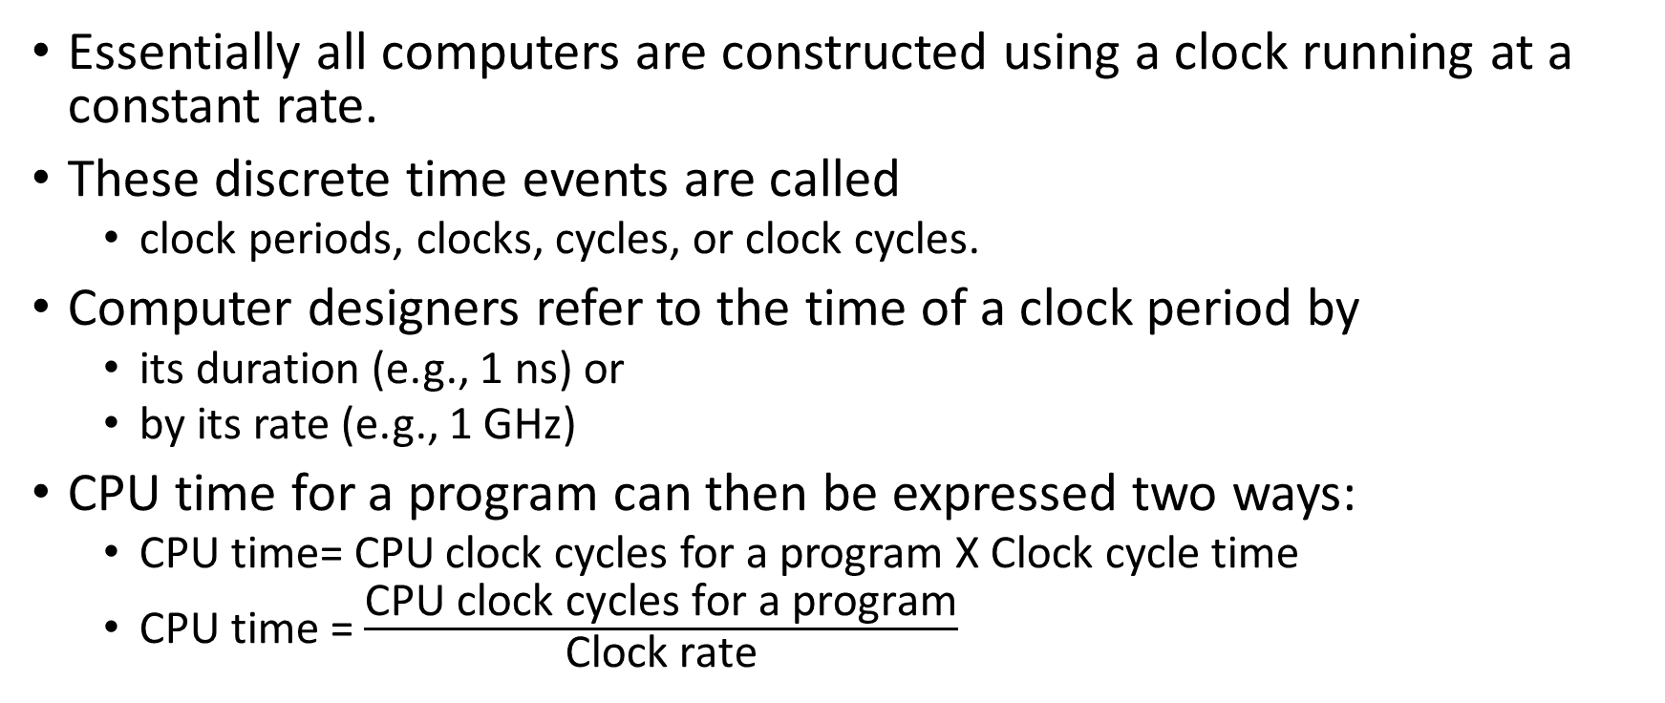
The Processor Performance Equation
Essentially all computers are constructed using a clock running at a constant rate.
These discrete time events are called
clock periods, clocks, cycles, or clock cycles.
Computer designers refer to the time of a clock period by
its duration (e.g., 1 ns) or
by its rate (e.g., 1 GHz)
CPU time for a program can then be expressed two ways:
CPU time= CPU clock cycles for a program X Clock cycle time
CPU time = $\frac{\text{CPU} \text{clock} \text{cycles} \text{for} \text{a} \text{program}}{\text{Clock} \text{rate}}$

Slide 19
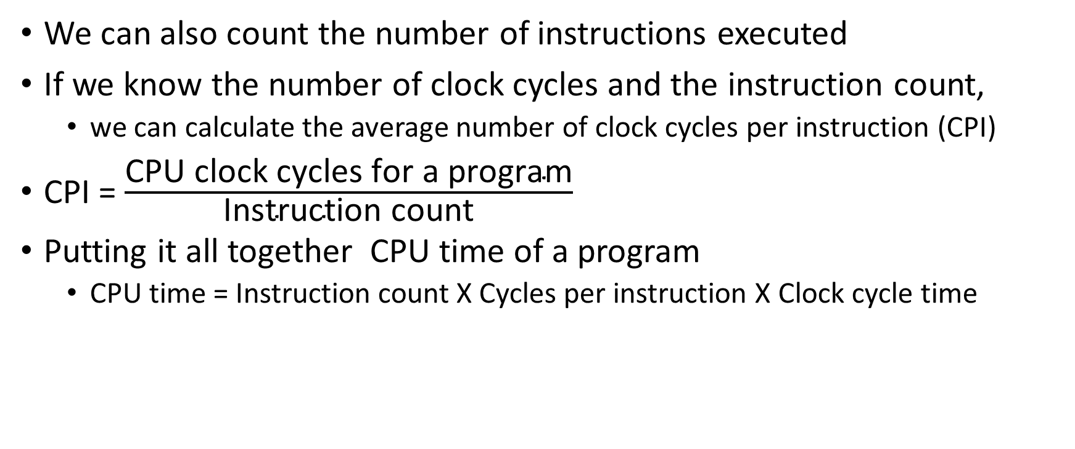
The Processor Performance Equation
We can also count the number of instructions executed
If we know the number of clock cycles and the instruction count,
we can calculate the average number of clock cycles per instruction (CPI)
CPI = $\frac{\text{CPU} \text{clock} \text{cycles} \text{for} \text{a} \text{program}}{\text{Instruction} \text{count}}$
Putting it all together CPU time of a program
CPU time = Instruction count X Cycles per instruction X Clock cycle time

Slide 20
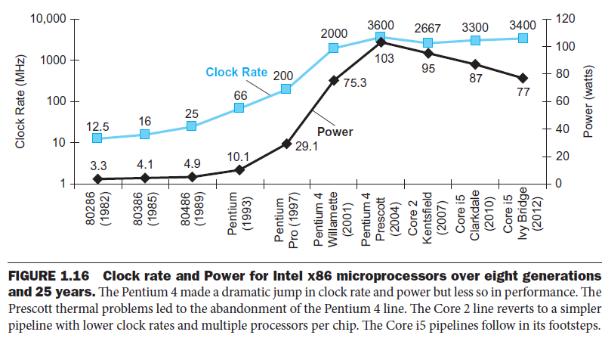
Clock and power

Slide 21
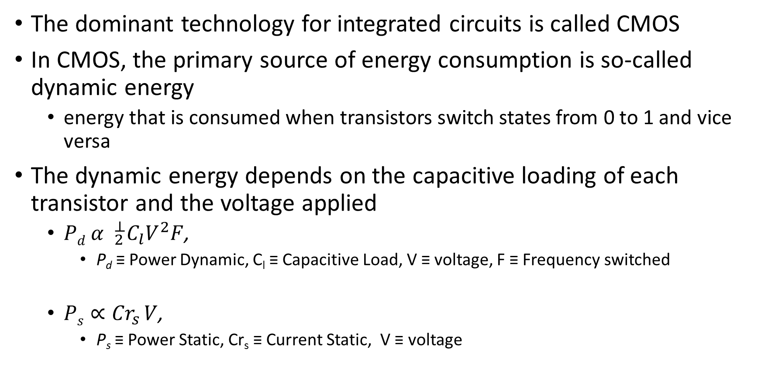
Clock and power
The dominant technology for integrated circuits is called CMOS
In CMOS, the primary source of energy consumption is so-called dynamic energy
energy that is consumed when transistors switch states from 0 to 1 and vice versa
The dynamic energy depends on the capacitive loading of each transistor and the voltage applied
$Pd{ α }_{2}^{⊥}C_{l}V^{2}F$,
P_{d} ≡ Power Dynamic, C_{l} ≡ Capacitive Load, V ≡ voltage, F ≡ Frequency switched
$Ps∝{Cr}_{s }V$,
P_{s} ≡ Power Static, Cr_{s} ≡ Current Static, V ≡ voltage

Slide 22
Fallacies and Pitfalls
Fallacy: Computers have been built in the same, old-fashioned way for far too long, and this antiquated model of computation is running out of steam.
Pitfall: Ignoring the inexorable progress of hardware when planning a new machine.

Slide 23
Fallacy and Pitfall
Pitfall:
Expecting the improvement of one aspect of a computer to increase overall performance by an amount proportional to the size of the improvement.
Example:
Suppose a program runs in 100 seconds on a computer, with multiply operations responsible for 80 seconds of this time. How much do I have to improve the speed of multiplication if I want my program to run five times faster?
Ans.
Exec. time after improvement = exec. time unaffected + (Exec. Time affected / amount of improvement)
100/5 = (100 – 80) + (80 / n) ➔ 80/n = 0 ????

Slide 24


